Slide 1
Decision Trees
Lei Qian, Ph.D.

Slide 2
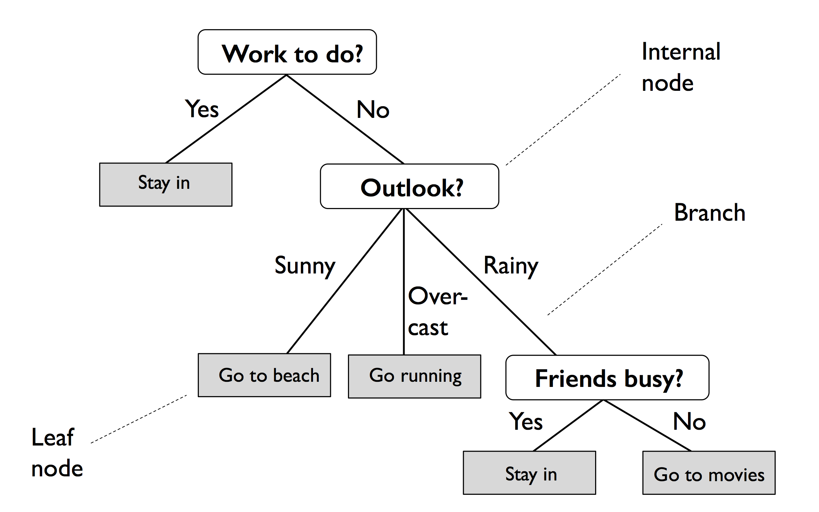
Decision Tree
Decision tree classifiers are classifiers that use tree like model to predict outcomes. Based on the features in a training set, the decision tree model learns a series of questions to infer the class labels of the samples

Slide 3
Decision Tree
A decision tree is a directed tree consists of nodes, edges (branches) and leaves.
Each node specifies a test on an attribute
Each branch corresponds to an attribute value or condition
Leaves represent a class or decision.

Slide 4
Decision Tree
Advantages of decision trees:
Simple to understand and to interpret. Trees can be visualized.
Requires little data preparation. Other techniques often require data normalization, dummy variables need to be created and blank values to be removed.
The cost of using the tree (i.e., predicting data) is logarithmic in the number of data points used to train the tree.
Able to handle both numerical and categorical data. Other techniques are usually specialized in analyzing datasets that have only one type of variable.
Able to handle multi-output problems.
Uses a white box model. If a given situation is observable in a model, the explanation for the condition is easily explained by Boolean logic. By contrast, in a black box model (e.g., in an artificial neural network), results may be more difficult to interpret.
Possible to validate a model using statistical tests. That makes it possible to account for the reliability of the model.
Performs well even if its assumptions are somewhat violated by the true model from which the data were generated.

Slide 5
Decision Tree
The disadvantages of decision trees include:
Decision-tree learners can create over-complex trees that do not generalize the data well (overfitting). Mechanisms such as pruning, setting the minimum number of samples required at a leaf node or setting the maximum depth of the tree are necessary to avoid this problem.
Decision trees can be unstable because small variations in the data might result in a completely different tree being generated. This problem is mitigated by using decision trees within an ensemble.
The problem of learning an optimal decision tree is known to be NP-complete under several aspects of optimality and even for simple concepts. Consequently, practical decision-tree learning algorithms are based on heuristic algorithms such as the greedy algorithm. Such algorithms cannot guarantee to return the globally optimal decision tree.
Decision tree learners create biased trees if some classes dominate. It is therefore recommended to balance the dataset prior to fitting with the decision tree.

Slide 6
Decision Tree Algorithm
A decision tree is built upon top-down, recursive, divide and conquer method.
Select best feature for root node. Construct a branch for every possible value of that feature.
Split data into mutually exclusive subsets for each branch.
Repeat this process recursively using only the portion of data arriving at each node.
Stop when training examples can be perfectly classified -> create a leaf node with the class decision
There are multiple algorithms for decision trees. Popular algorithms include ID3, C4.5 and CART.

Slide 7
How to choose the splitting attribute?
• Information Gain (used in ID3, C4.5)
• Gain Ratio (used in C4.5)
• Gini Measure (used in CART)

Slide 8
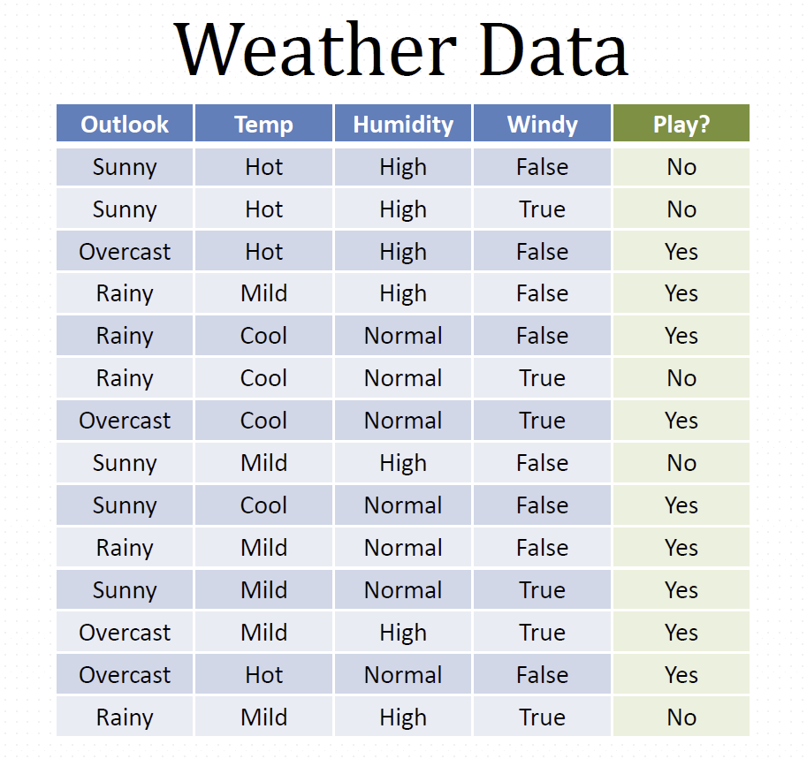
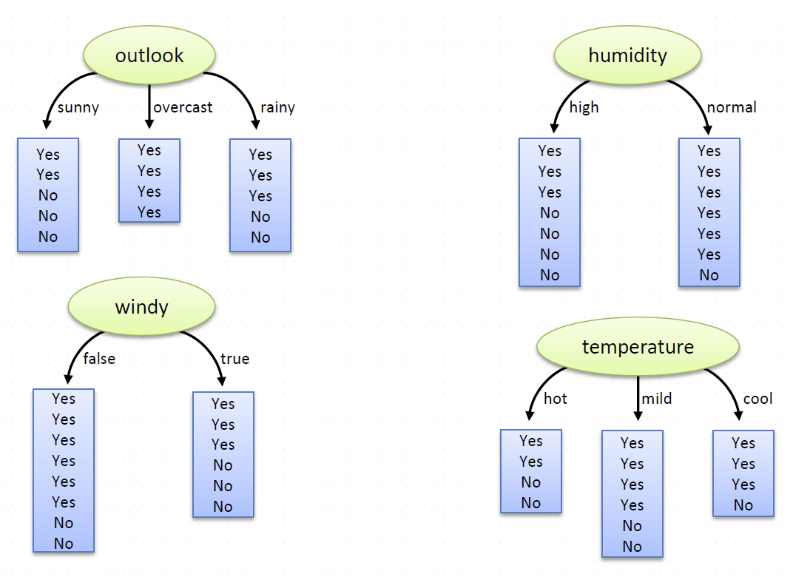
Weather and decision
Which attribute to select?

Slide 9
Information Gain
Information gain (IG) measures how much “information” an attribute gives us about the class.
attributes that perfectly partition should give maximal information
unrelated attributes should give no information
It measures the reduction in entropy or Gini
Entropy and Gini: (im)purity in an arbitrary collection of examples

Slide 10

Entropy
Entropy is a measurement of information impurity.
Assume there are K classes and each has probability $p_{1},p_{2},…,p_{K}$.
Entropy = $−Σ_{i=1}^{K}p_{k}\log_{2}{p_{k}}$

Slide 11
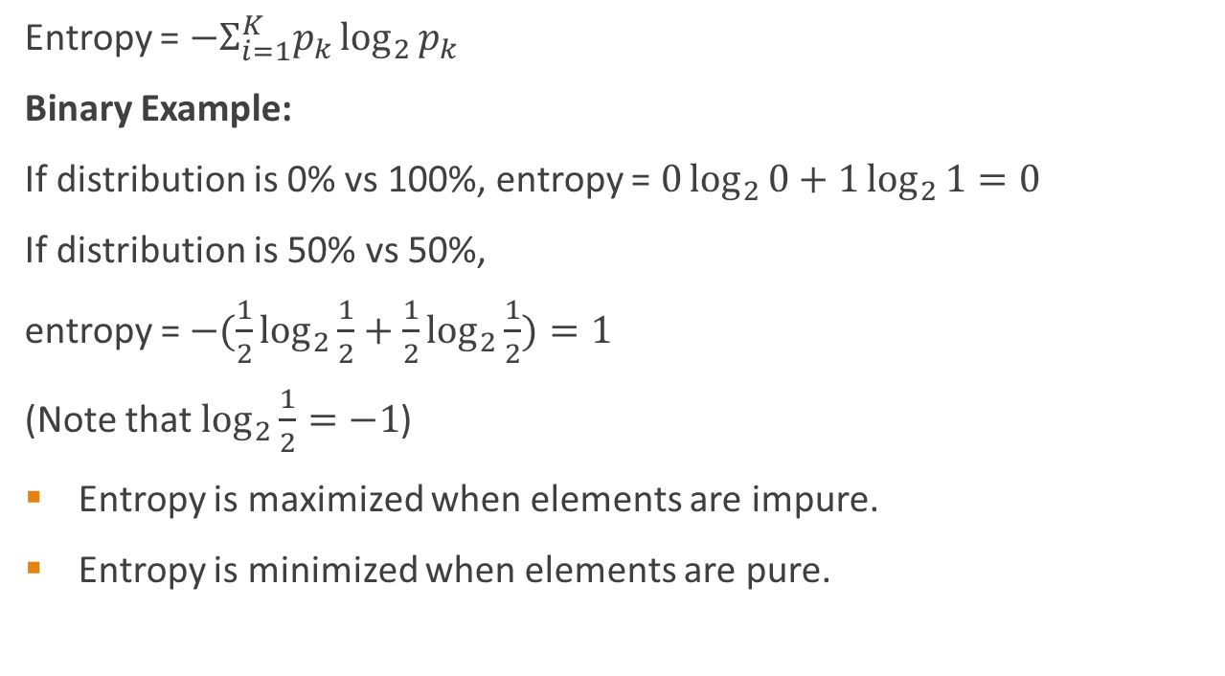
Entropy
Entropy = $−Σ_{i=1}^{K}p_{k}\log_{2}{p_{k}}$
Binary Example:
If distribution is 0% vs 100%, entropy = $0\log_{2}{0+1\log_{2}{1}=0 }$
If distribution is 50% vs 50%,
entropy = $−(\frac{1}{2}\log_{2}{\frac{1}{2}+\frac{1}{2}\log_{2}{\frac{1}{2}})=1}$
(Note that $\log_{2}{\frac{1}{2}=−1}$)
Entropy is maximized when elements are impure.
Entropy is minimized when elements are pure.

Slide 12
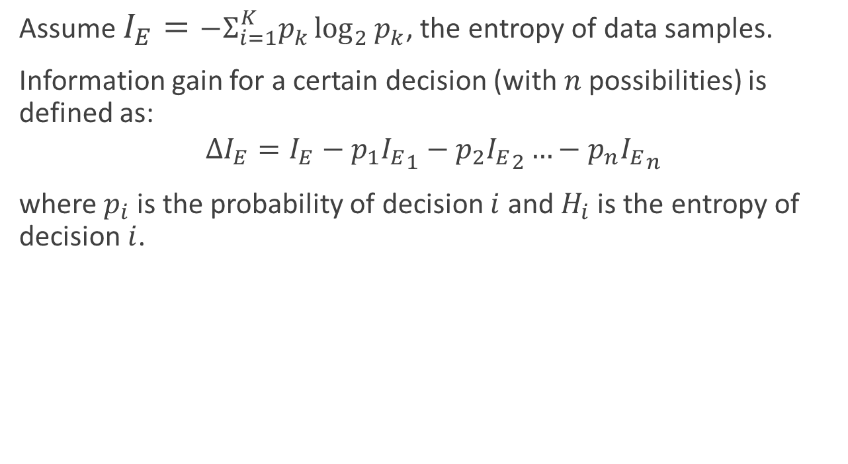
Information gain
Assume $I_{E}=−Σ_{i=1}^{K}p_{k}\log_{2}{p_{k}}$, the entropy of data samples.
Information gain for a certain decision (with $n$ possibilities) is defined as:
$$ΔI_{E}=I_{E}−p_{1}{I_{E}}_{1}−p_{2}{I_{E}}_{2}…−p_{n}{I_{E}}_{n}$$
where $p_{i}$ is the probability of decision $i$ and $H_{i}$ is the entropy of decision $i$.

Slide 13
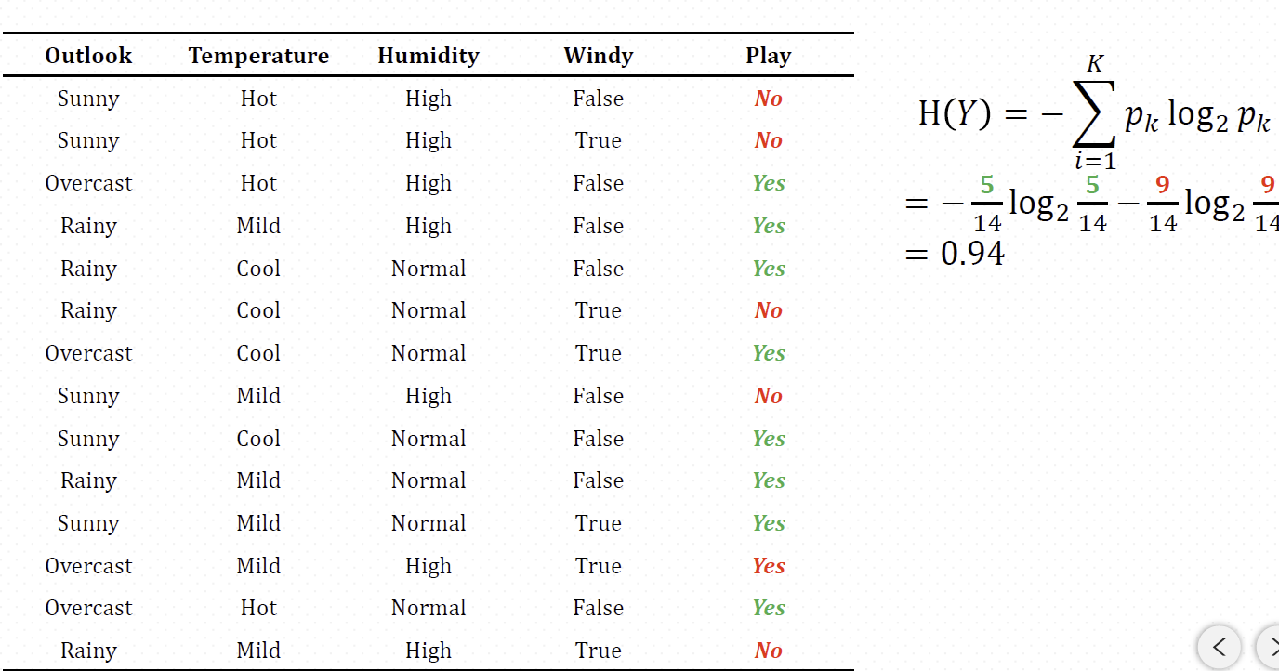
Information gain Example
The entropy of the target is 0.94 (9 Yes 5 No).

Slide 14
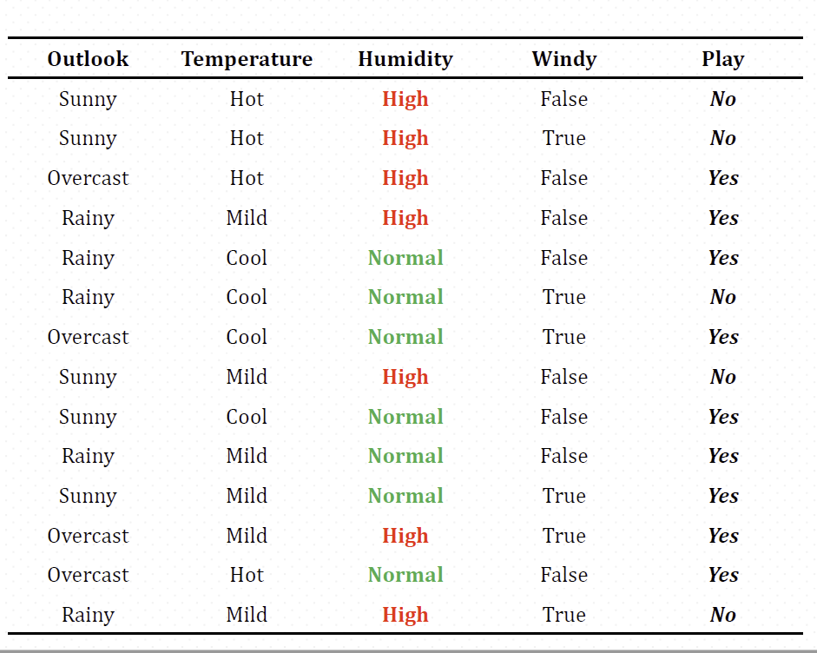
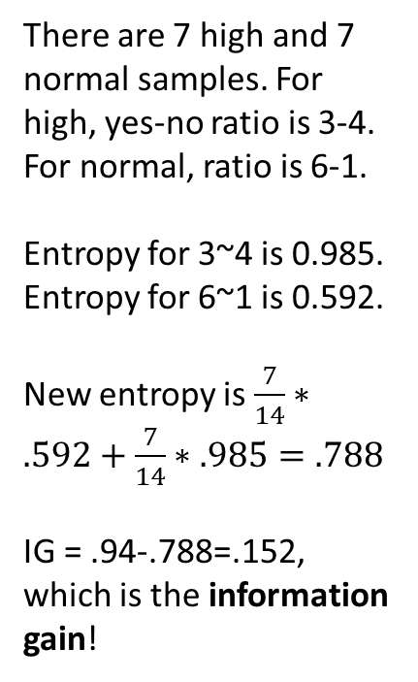
Information gain for Humidity
There are 7 high and 7 normal samples. For high, yes-no ratio is 3-4. For normal, ratio is 6-1.
Entropy for 3~4 is 0.985. Entropy for 6~1 is 0.592.
New entropy is $\frac{7}{14}∗.592+\frac{7}{14}∗.985=.788$
IG = .94-.788=.152, which is the information gain!

Slide 15
Information gain Example
Information gain for each feature:
Outlook=0.247
Temperature=0.029
Humidity=0.152
Windy=0.048
Initial split is on outlook, because it is the feature with the highest information gain.

Slide 16
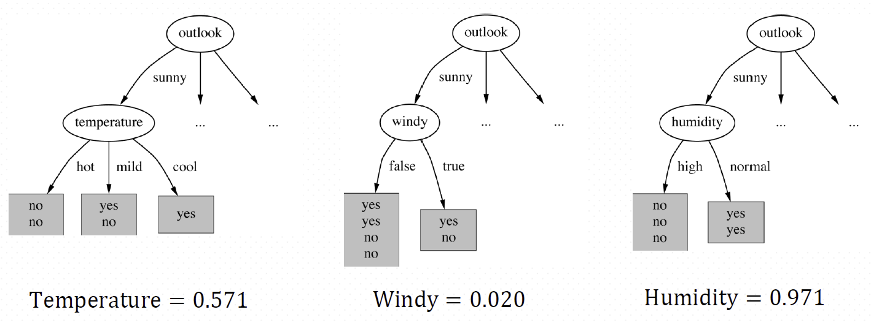
Information gain Example
Now we search for the best split for the next level:

Slide 17
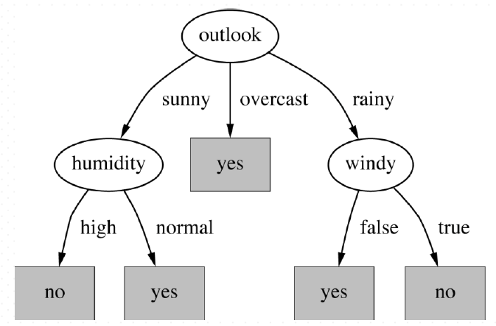
Information gain Example
The final decision tree:
Note that not all leaves need to be pure; sometimes similar (even identical) instances have different classes. Splitting stops when data cannot be split any further.

Slide 18
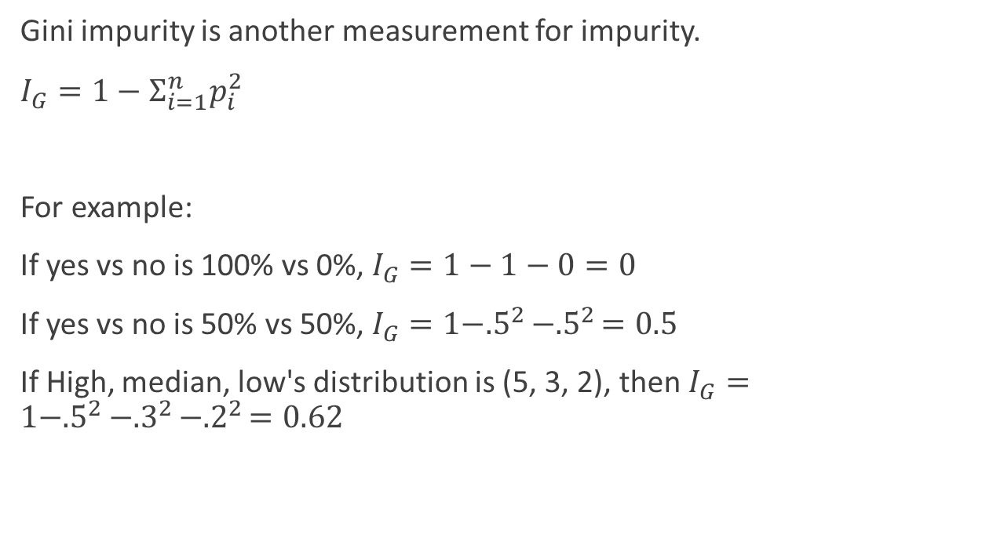
Gini
Gini impurity is another measurement for impurity.
$I_{G}=1−Σ_{i=1}^{n}p_{i}^{2}$
For example:
If yes vs no is 100% vs 0%, $I_{G}=1−1−0=0$
If yes vs no is 50% vs 50%, $I_{G}=1−{.5}^{2}−{.5}^{2}=0.5$
If High, median, low's distribution is (5, 3, 2), then $I_{G}=1−{.5}^{2}−{.3}^{2}−{.2}^{2}=0.62$

Slide 19
Gini
Gini Can be used to replace entropy in building decision trees. The algorithm is nearly identical.
In practical, Gini and Entropy often yield similar results. But not always same.

Slide 20
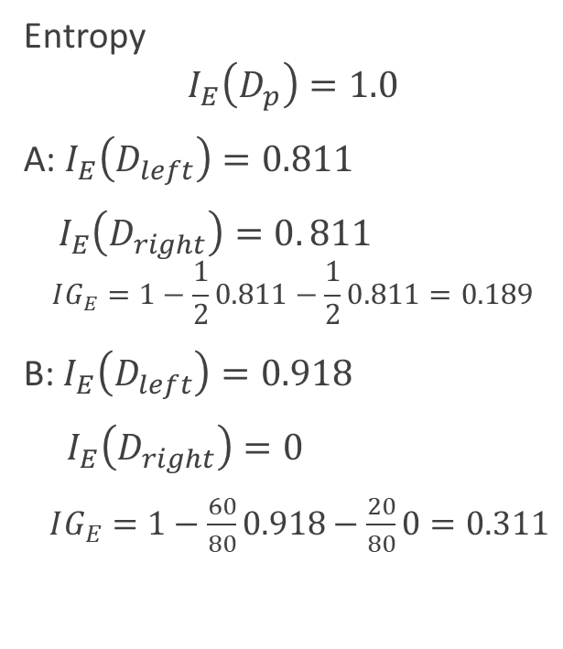
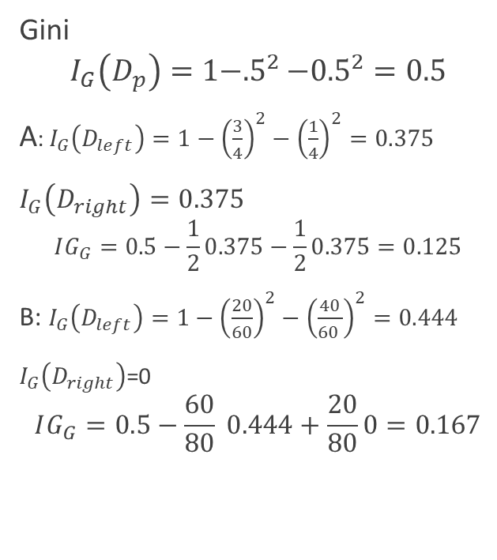
Entroy vs Gini
Entropy
$$I_{E}\left(D_{p}\right)=1.0$$
A: $I_{E}\left(D_{left}\right)=0.811$
$I_{E}\left(D_{right}\right)=0. 811$
$$IG_{E}=1−\frac{1}{2}0.811−\frac{1}{2}0.811=0.189$$
B: $I_{E}\left(D_{left}\right)=0.918$
$I_{E}\left(D_{right}\right)=0$
$IG_{E}=1−\frac{60}{80}0.918−\frac{20}{80}0=0.311$
Gini
$$I_{G}\left(D_{p}\right)=1−{.5}^{2}−{0.5}^{2}=0.5$$
A: $I_{G}\left(D_{left}\right)=1−{\left(\frac{3}{4}\right)}^{2}−{\left(\frac{1}{4}\right)}^{2}=0.375$
$I_{G}\left(D_{right}\right)=0.375$
$$IG_{G}=0.5−\frac{1}{2}0.375−\frac{1}{2}0.375=0.125$$
B: $I_{G}\left(D_{left}\right)=1−{\left(\frac{20}{60}\right)}^{2}−{\left(\frac{40}{60 }\right)}^{2}=0.444$
$I_{G}\left(D_{right}\right)$=0
$$IG_{G}=0.5−\frac{60}{80} 0.444+\frac{20}{80}0=0.167$$

Slide 21
Decision Tree in Scikit-Learn
from sklearn.tree import DecisionTreeClassifier
tree = DecisionTreeClassifier(criterion='gini', max_depth=4, random_state=1)
tree.fit(X_train, y_train)

Slide 22
Decision Tree in Scikit-Learn
A very nice property of decision trees is that we can visualize the tree comparing to many other machine learning algorithms that final estimators are mostly black boxes.
dot_data = export_graphviz(tree, filled=True, rounded=True,
class_names=['Setosa', 'Versicolor', 'Virginica'],
feature_names=['petal length', 'petal width'],
out_file=None)
graph = graphviz.Source(dot_data)
graph

Slide 23
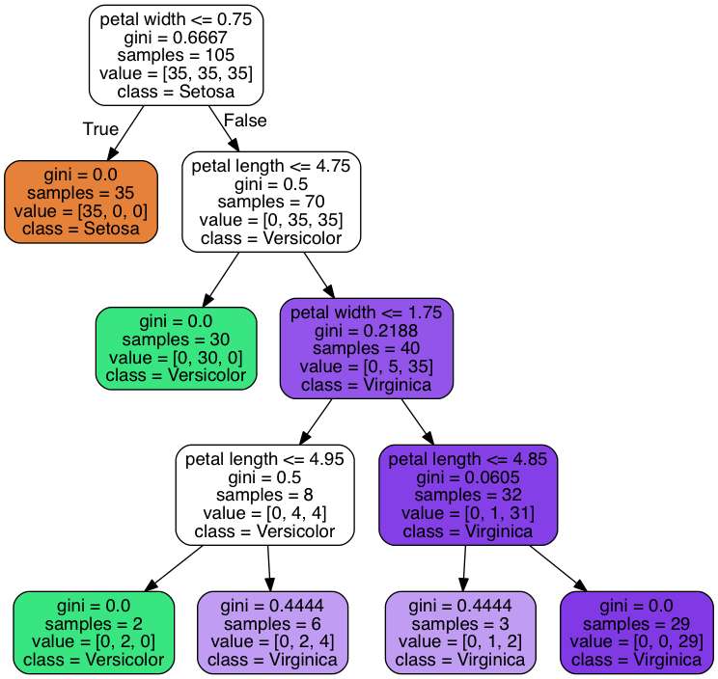
Example of a decision tree
The final decision tree:

Slide 24
Random Forest
Random forest is ensemble of decision trees. It works the following way:
1. Draw a random bootstrap sample of size n (randomly choose n samples from
the training set with replacement).
2. Grow a decision tree from the bootstrap sample. At each node:
a. Randomly select d features without replacement.
b. Split the node using the feature that provides the best split according to the objective function, for instance, maximizing the information gain.
3. Repeat the steps 1-2 k times.
4. Aggregate the prediction by each tree to assign the class label by majority
vote.

Slide 25
Random Forest in Scikit-Learn
from sklearn.ensemble import RandomForestClassifier
clf = RandomForestClassifier(n_estimators=100, max_depth=4, random_state=1)
clf.fit(X, y)
RandomForestClassifier has all parameters DecisionTreeClassifier has. But it has a few more parameters such as n_estimators, which is the number of trees in the forest.

